Slide 1
TSMC Enjoin
Team 4 (Group E)
隊名: 感謝台積電捐贈疫苗
組長: TCCD/涂家浩
組員: ERP/郭同益, APMSD/鄧雅心, TPOD/鍾秉諭, F18MITD/王羿婷, MTIT/陳志健
Mentor: APMSD/李哲銓

Slide 2
Outline
User Story
System
Feature
System Architecture
Live Demo

Slide 3
User Story (1/2)
Who
What
Why
喜歡喝咖啡且周遭較少喜歡喝咖啡的同仁
當有買一送一時，可以迅速找到有相同想法的人一起購買
可以享受折扣及認識其他愛喝咖啡的同仁

Slide 4
User Story (2/2)
Who
What
Why
揪團訂下午茶的同仁
找人一起訂下午茶
湊滿外送門檻或免運費門檻

Slide 5





System Architecture
Restful API
(GET/POST
DELETE/PUT)
back
front
back
Vue.js

Slide 6
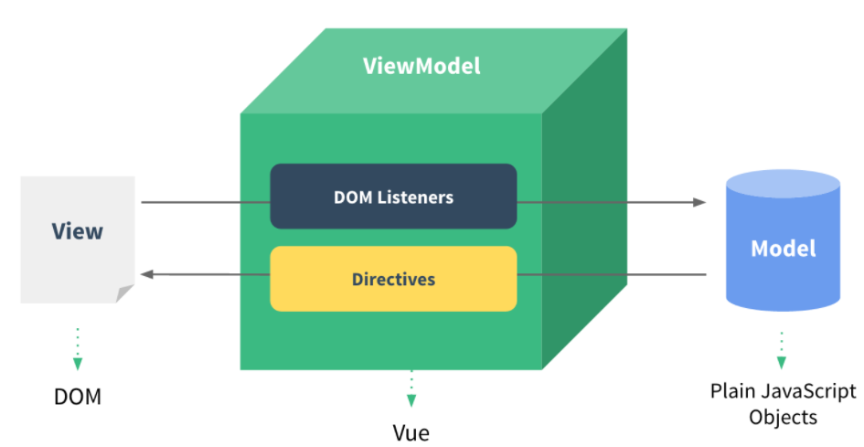
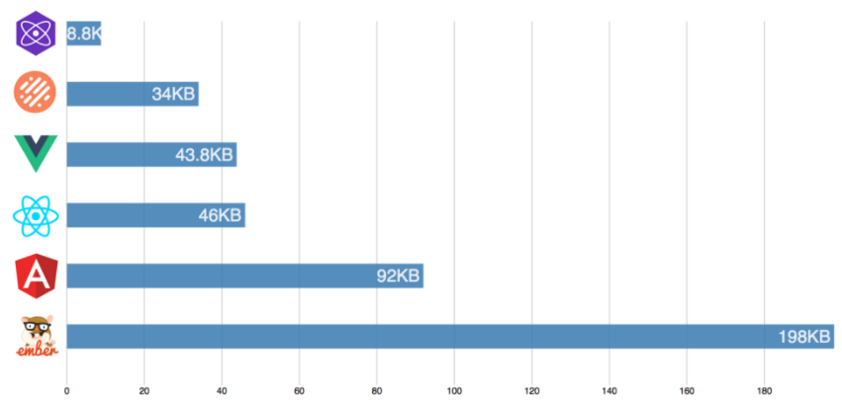

Advantage of Vue.js
Feather Weight A
Rapid Rendering time
Small size of framework
MVVM Architecture
Framework Size
Template Syntax B
Two-way data binding C
Reusable
Simplicity
MVVM Architectural pattern
“{{ }}”, “v-model” for bind data

Slide 7
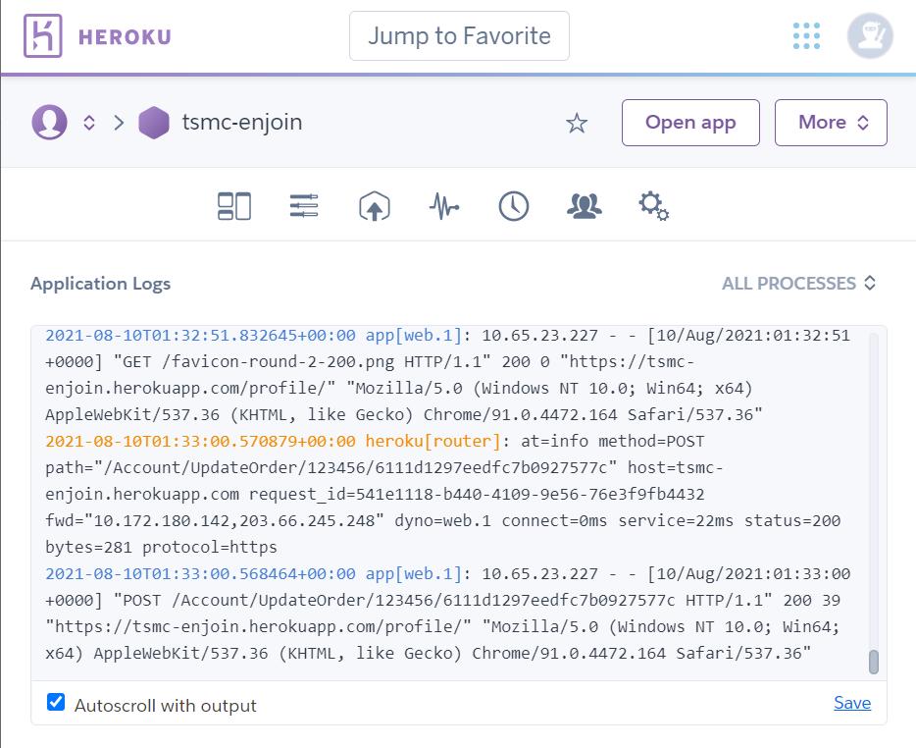
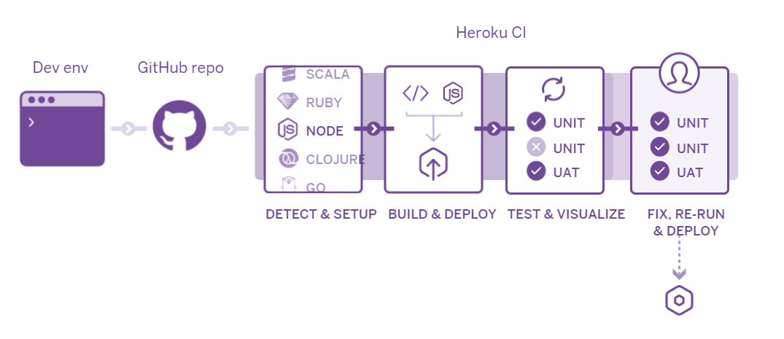

GitLab CI/CD with Heroku
Contents Here
CI/CD Pipelines
GitLab repo
CI/CD Pipelines
Heroku Logs

Slide 8
System Features
Order Management
Search Order
Order Management
Search
Order
Search by keyword or hashtags
Create, Edit
Join, Unjoin
Close, Delete
TSMC
Enjoin
Account
Visitor Mode
Register, Login, Logout
Password is encrypted in database
Account

Slide 9
Order Lifecycle
New
1. New
創建揪團單時可選擇會面時間、會面地點、需求人數 、店家 及品項 等
In Progress
2. In Progress
創建單子後
有興趣者即可加入 揪團者可以編輯揪團單(會面時間、會面地點、需求人數 等)
已加入者也可臨時退出
Completed
3. Complete
已達欲揪團人數，未加入者無法再加入
Closed
4. Closed
成團，確立參與人員

Slide 10
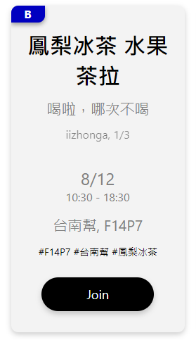
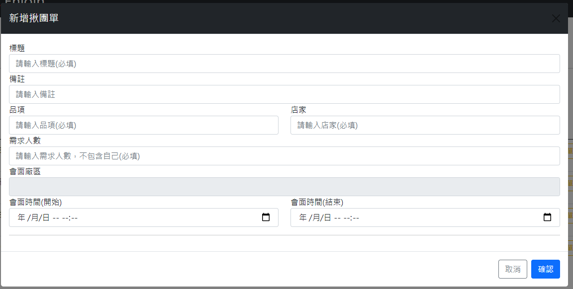
System GUI

Slide 11
Future Work - AI
User Behavior Data Analysis & Machine Learning
10%
30%
50%
10%
Tue.
Wed.
Thu.
Fri.
Order Store Analysis
Order Count Prediction

Slide 12
LIVE DEMO

Slide 13
THANK YOU

Slide 14
Back Up

Slide 15
User Story
Who
What
Why
公司福利部人員
分析員工平時常訂購哪些商品及對於那些店家較有興趣
提供更貼近於員工的福利政策

Slide 16

Search Order
Search
透過 search key 去搜尋各個 order
or 直接點擊 hashtag 來搜尋
search
user

Slide 17
Display Order
In progress, Completed,
Closed order list
使用者可以去觀看各種狀態的order，In progress只關注在未過期的order
Joined Order List
使用者可以去觀看自己參與的揪團單，並選擇要不要繼續跟團
Created Order List
使用者可以去看自己創建的揪團單子的狀態. 若是人數已滿就可以結單

Slide 18
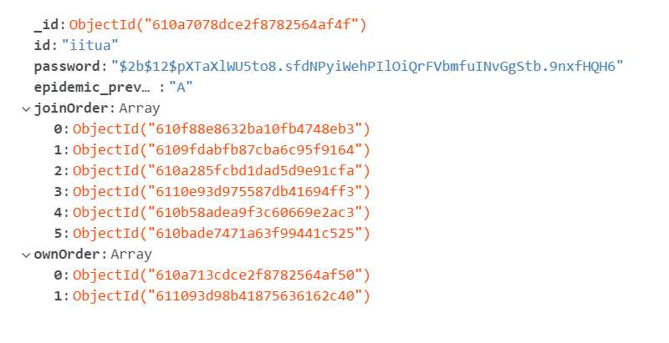
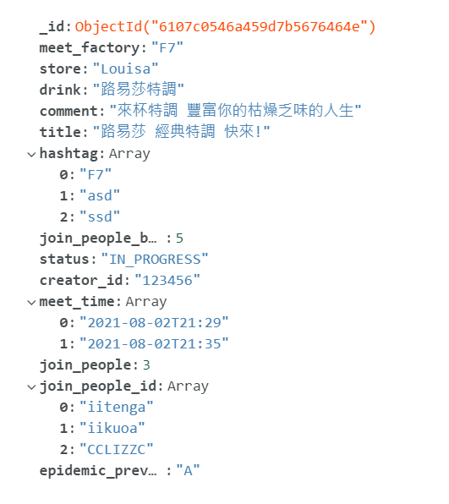
Table Design in MongoDB
Account Table
Order Table

